Slide 1
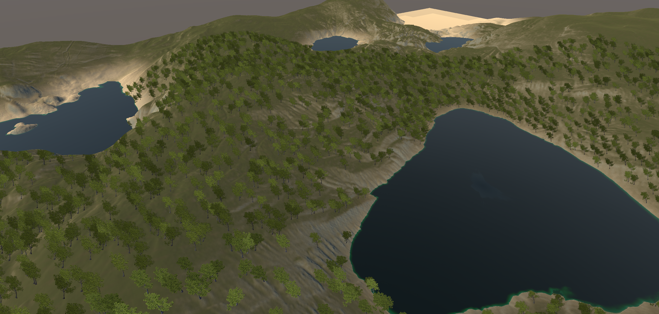
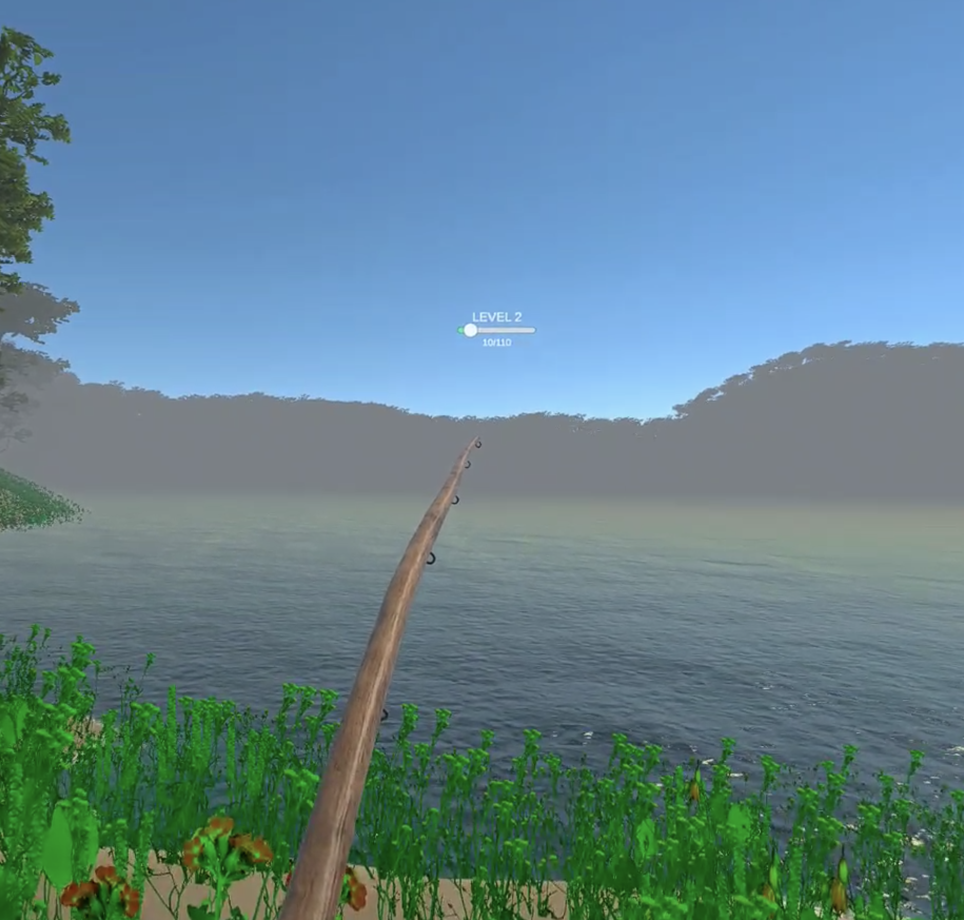
Fishing Simulator VR
Yuxiao Zou

Slide 2
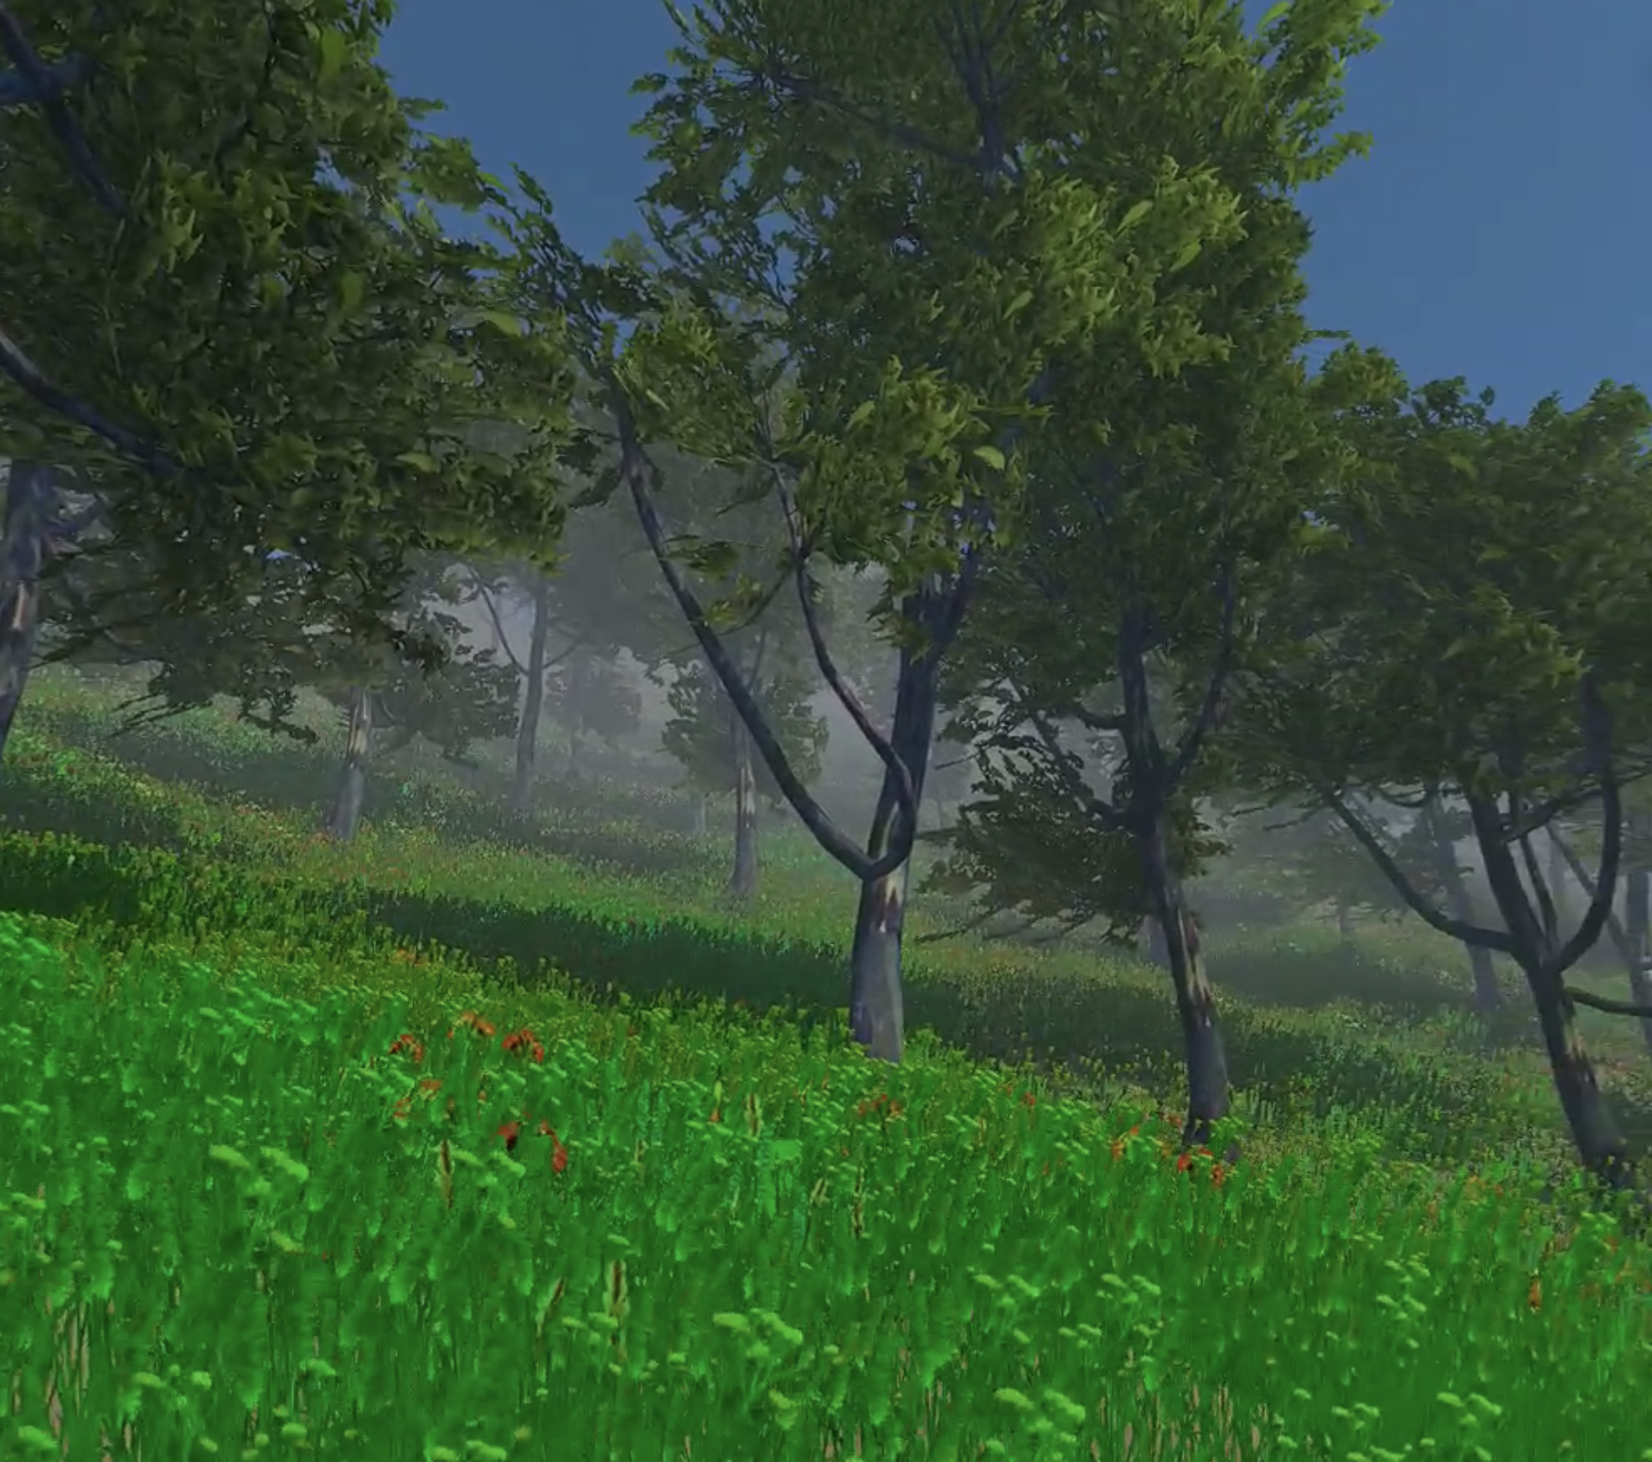
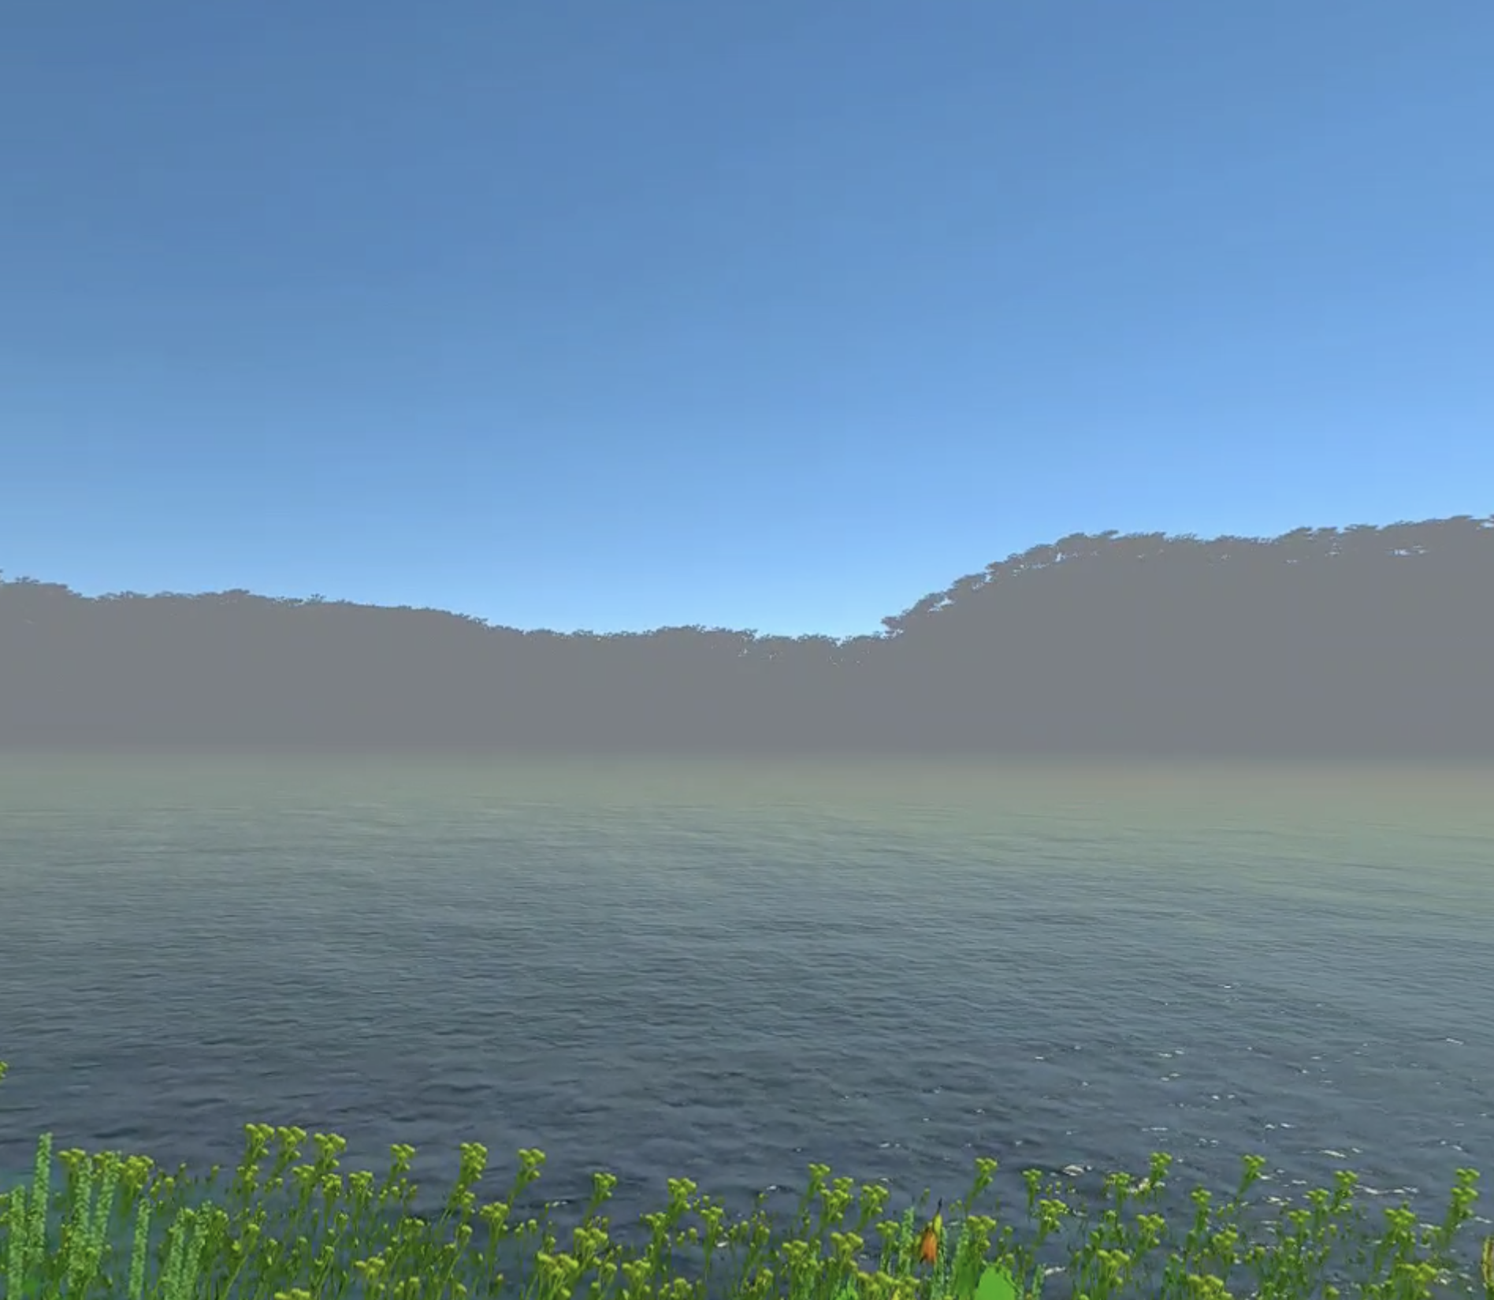
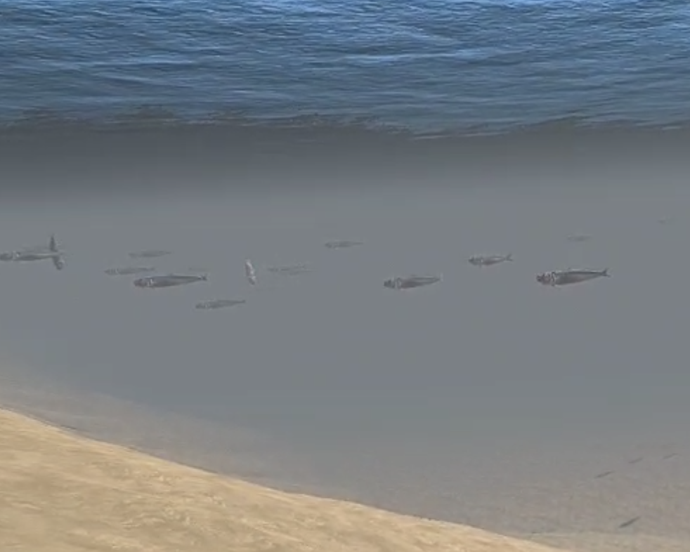
Open World
1
Explore a vast open world filled with numerous lakes to discover and fish in. Each lake has its unique characteristics and fish to catch.
Beautiful Scene
2
Immerse yourself in a stunning and immersive world filled with beautiful scenery, including lush forests, flowing rivers, and towering mountains.
Sound of Nature
3
Experience the calming and soothing sounds of nature as you fish, including chirping birds, rustling leaves, and flowing water.

Slide 3
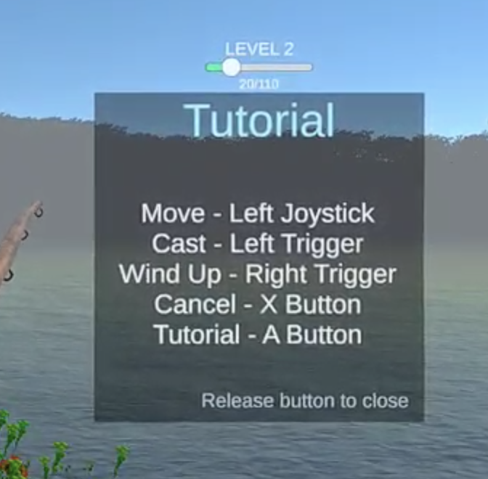
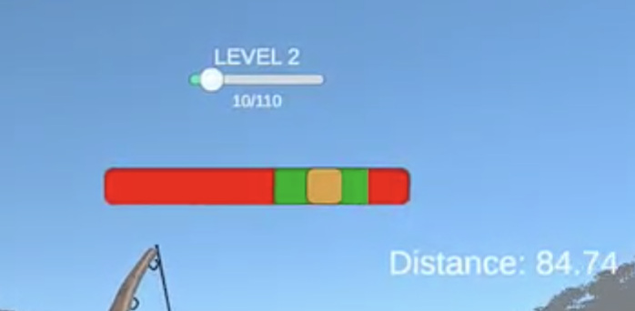
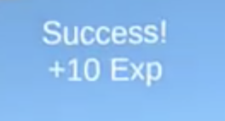

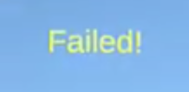

Battle System
Test your fishing skills with a challenging and intense battle system. Catch different types of fish and use different strategies to reel them in, all while trying to keep them from escaping.

Slide 4
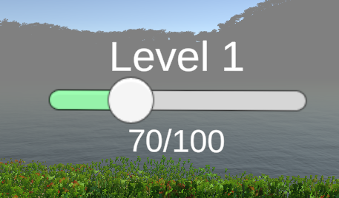

Level System
Progress through the game with a leveling system that rewards you with experience points for every fish you catch. Gain new abilities and upgrades as you level up, and become a master fisherman.

Slide 5
Self Reflection
Strength
Failure
VR development: Experience and proficiency in developing VR games with Unity.
Game mechanics design: The ability to design engaging and intuitive game mechanics, such as fishing mechanics.
Game optimization: Knowledge of game optimization techniques to ensure the game runs smoothly and efficiently on a range of devices.
Project Management: Breaking down tasks into manageable pieces that can be completed within a specific timeframe.
More detailed animations: Adding more detailed animations to the fish, characters, and environment would enhance the visual experience.
More diverse fish species: Adding more types of fish would increase the variety and make it more interesting for players.
Map system: It will be easily for players to get lost in the forest if we don’t have a map system in the game since it’s open world.
1
2

Slide 6
Thank you !
Yuxiao Zou

